Slide 1
YOUR LOGO HERE
x
Launch Event

Slide 2
<Programme Key Messaging Here>
Notes:
*Senior leader welcomes the group*
At [company name] we want to make sure that we’re all taking care of our mental wellbeing, every day.
[phrase from key messaging in Playbook]

Slide 3
That’s why we have teamed up with the experts in wellbeing, Groov.
With their help, we’re going to embed a culture of wellbeing.
Notes:
That’s why we have teamed up with Groov, a wellbeing organisation founded by former All Black and mental health advocate Sir John Kirwan. They’re here to help us embed a culture of wellbeing at [company name].

Slide 4
Wellbeing is different for everyone, and it goes
up and down.
Groov will help us find what works to stay in our Groov
and maintain optimal wellbeing.
Notes:
They’re here to help us embed a culture of mental wellbeing at [company name].

Slide 5
What does that mean?
It means making wellbeing part of every day, celebrating and sharing how we look after ourselves, and building it into the rhythms and rituals of the workday. It’s creating a wellbeing-first culture.

Slide 6
Feeling good.
Functioning well.
We’re going to find our Groov by discovering what works for our organisation, leaders, and people to live wellbeing.

Slide 8
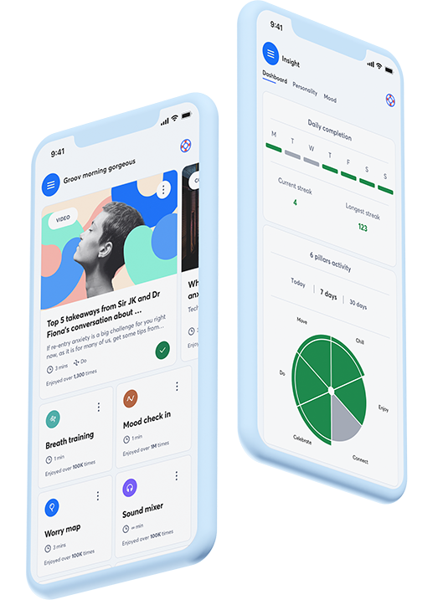
App draw.
To enter the draw and win a <type prize>, download and install the app now!
Set up your account and connect to our workplace to be in to win.
You have 30 days to enter and <type number of winners> winners will be announced on <type date>!
Notes:
*If you like, plan a prize draw to encourage adoption of the App* Edit the prize, winner/winners and date of announcement. Delete this slide if not needed.

Slide 9
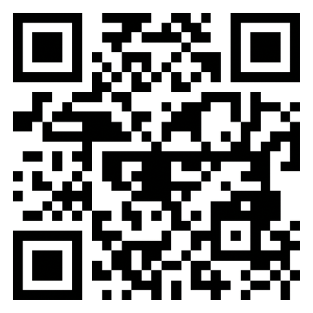
Ready to find your Groov?
Scan the QR code to
download the app.
Notes:
*Remind the team to download the app if they haven’t yet*
Discover tools, expert advice, inspiration, and boost your wellbeing daily!

Slide 10
Next steps:
Surveys to find where we are at
Download and explore the Groov app

